Slide 1
STRATEGY Pattern
Strategy pattern is behavior pattern. This pattern defines family of algorithms and encapsulate each one in object and make them interchangeable.
This makes algorithms very independent from the clients who uses it. [Runtime change of algorithm]

Slide 2
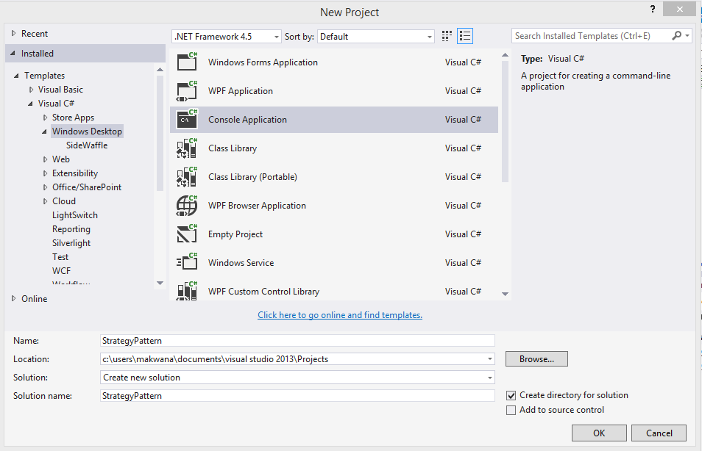

Slide 3
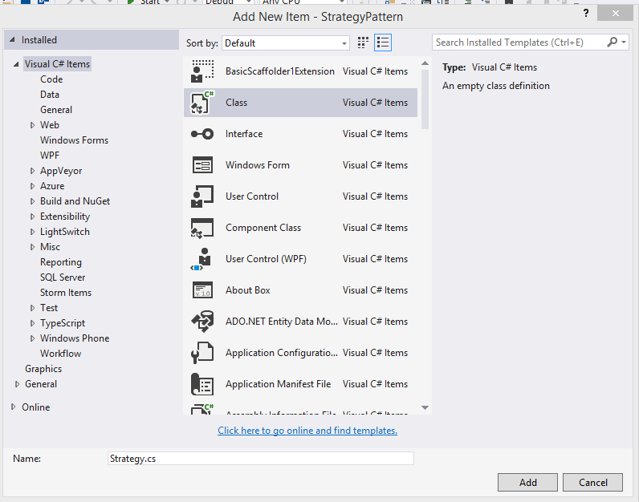

Slide 4
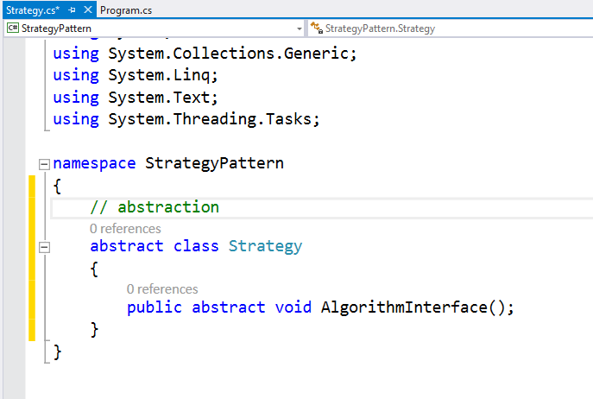

Slide 5
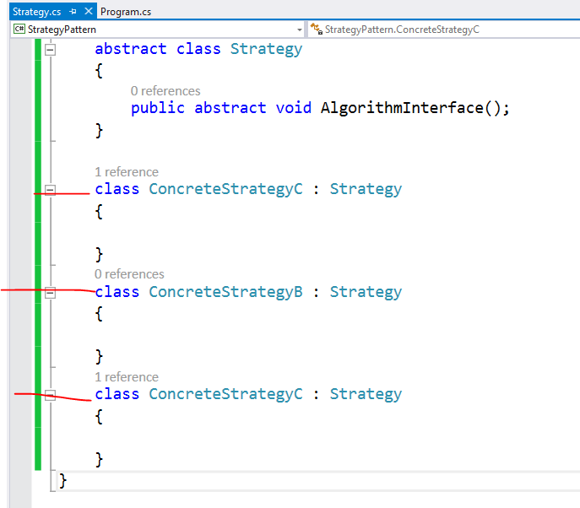

Slide 6
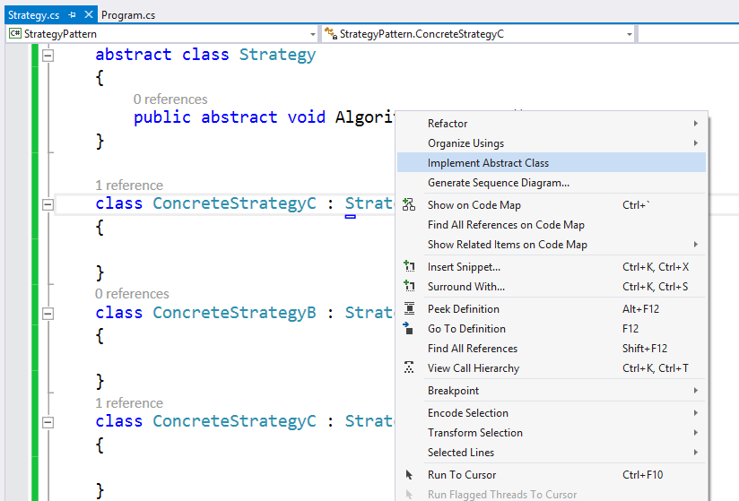

Slide 7
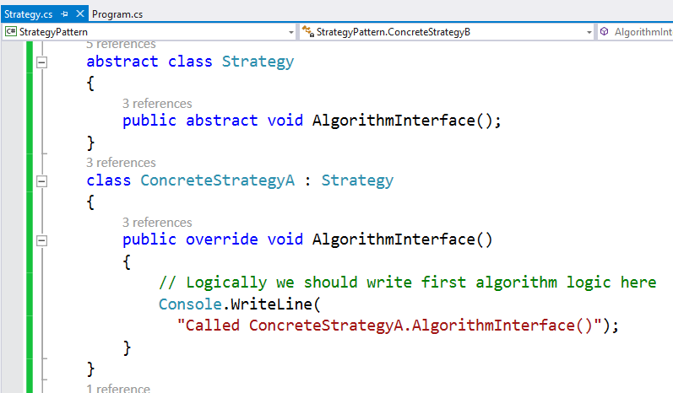

Slide 8
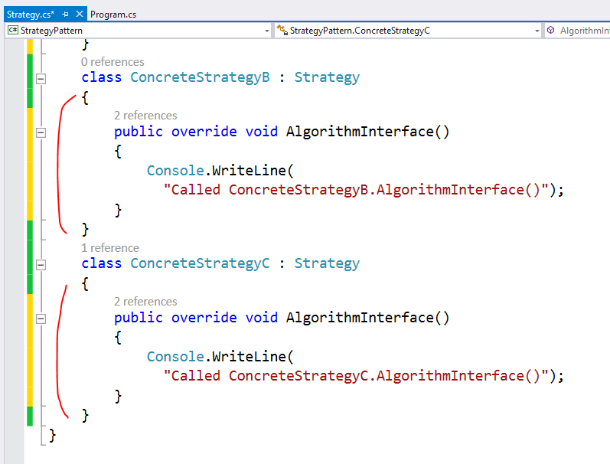

Slide 9
Up to this point this is very simple
Actual magic is in calling these method in main
But for that we need context by which we can
call this

Slide 10
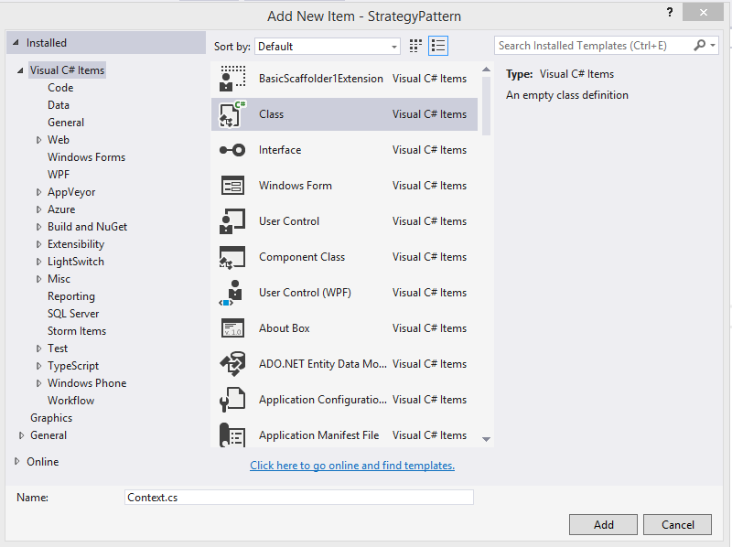

Slide 11
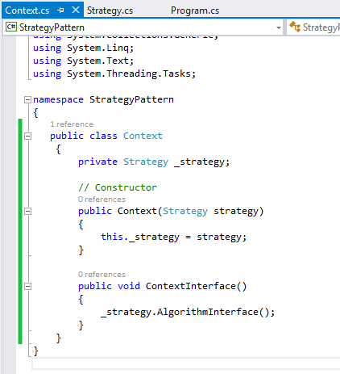


Slide 12
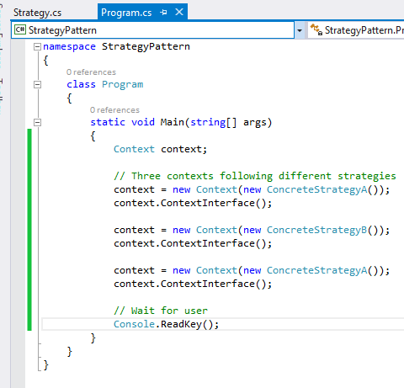

Slide 13


Slide 14
This is just basic understanding of this pattern to make it real let’s add some algorithms in this sample now

Slide 15
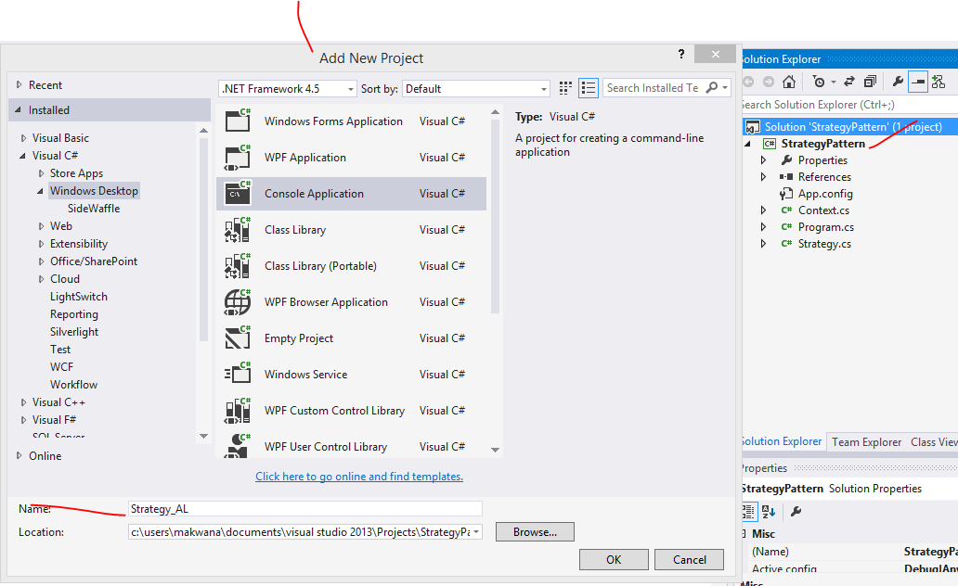

Slide 16
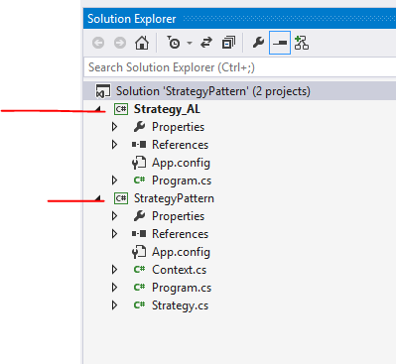

Slide 17
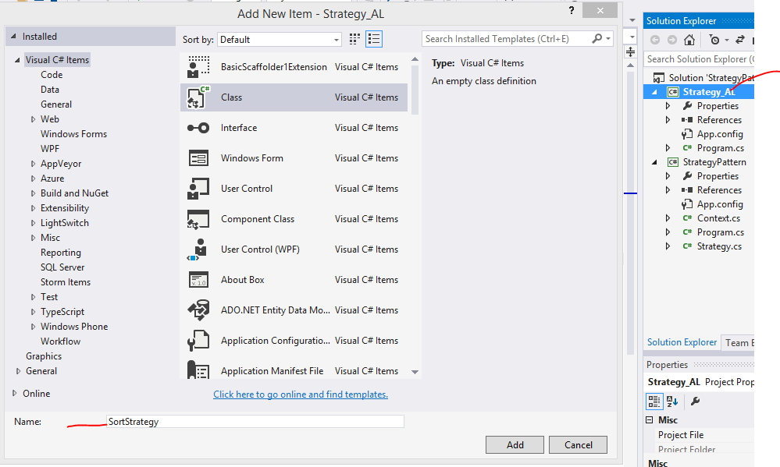

Slide 18
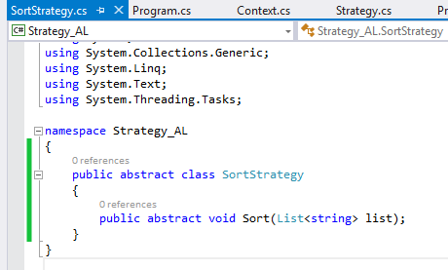

Slide 19
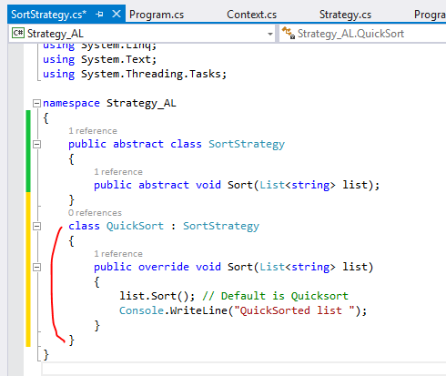

Slide 20
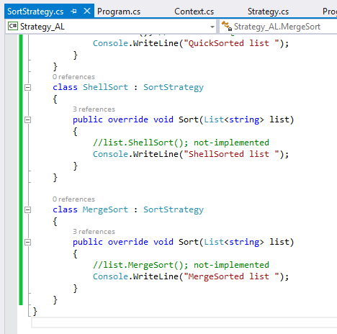

Slide 21
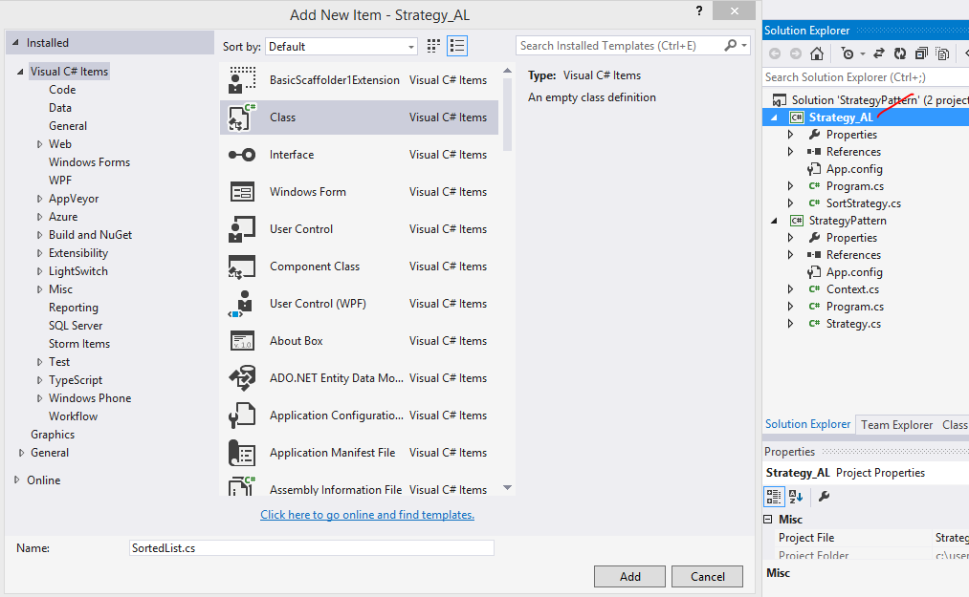

Slide 22
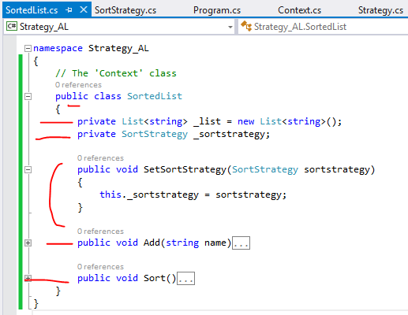

Slide 23
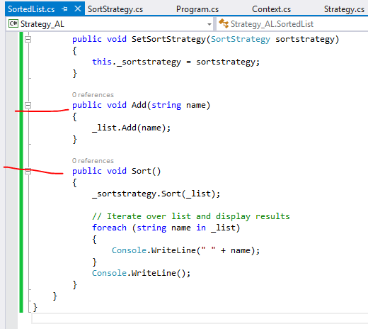

Slide 24
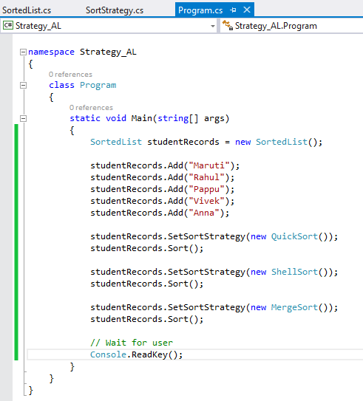

Slide 25
